Slide 1
Spark Runtime Architecture
Pravin Y Pawar

Slide 2
Motivation
Till now executed applications on the local (standalone) mode
How to move to the cluster?
If same application needs to be run on the cluster, nothing needs to be changed!
Just need to add more machines and run it in the cluster mode!
All this possible because of high level API of Spark!
Can rapidly prototype applications on smaller dataset locally
Run unmodified code on very large clusters !

Slide 3
Spark Runtime Architecture
Components of Distributed Spark Application
Source : Spark intro blog

Slide 4
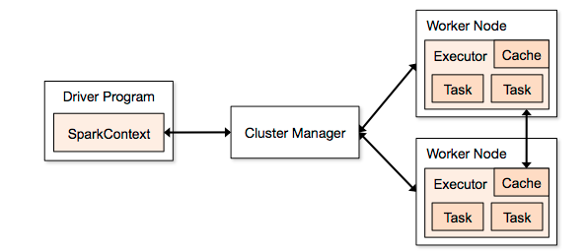
Spark Runtime Architecture (2)
Uses Master/Slave architecture with one central coordinator and many distributed workers
Central coordinator – driver
Driver communicates with large number of workers – executors
Both runs in their separate Java processes
Driver and Executor together termed as Spark Application!
Spark application launched on set of machines using external service called cluster manager
Spark has built-in standalone cluster manager
Also supports Hadoop YARN, Apache Mesos as cluster managers

Slide 5
Driver
Driver is the central coordinator for Spark application
Runs in separate Java process
It’s the process where main() method of program runs
It’s the process running the user code that
Creates SparkContext
Creates RDDs
Performs transformations and actions
Once the driver terminates, application ends
Two responsibilities
Converting user program into tasks
Scheduling tasks on executors

Slide 6
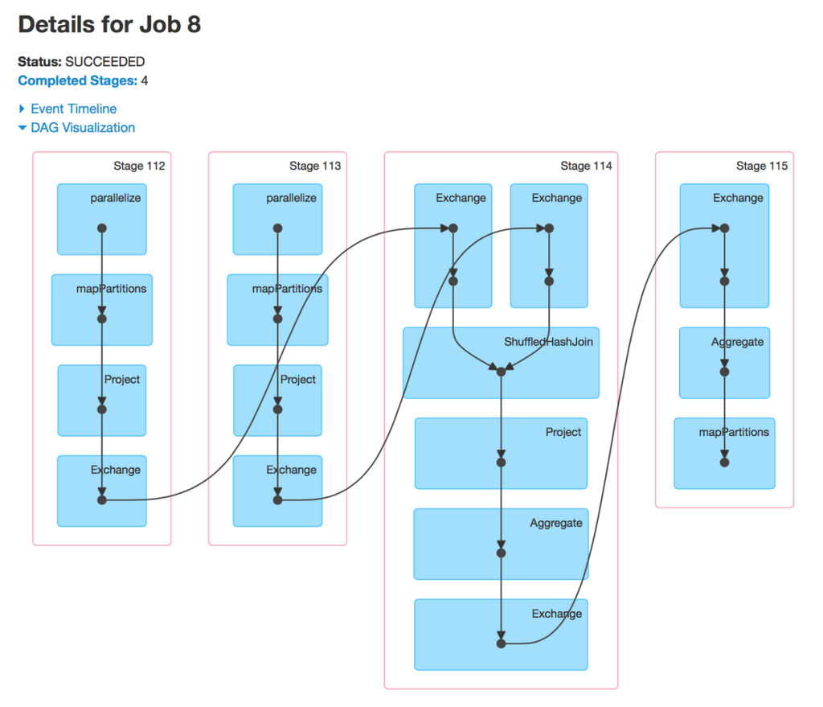
Driver (2)
Two Duties - Converting user program into tasks
Converting user program into tasks
Physical execution unit is called as task
Smallest unit of work – task!
Programs creates SparkContext, Create RDDs and perform transformations, actions on RDDs
Implicitly a logical directed acyclic graph (DAG) of operations is created
When driver runs, it coverts the DAG into physical execution plan
Converts execution plan into stages which in turn consists of tasks
Tasks are bundled up and sent to the cluster
Source : Databricks docs

Slide 7
Driver (3)
Two Duties – Tasks Scheduling
Scheduling the tasks on executors
With execution plan, Driver needs to coordinate scheduling of tasks on executors
When executor starts, it gets registered with driver, so driver has complete info about them
Executor is process capable of running tasks and storing RDD data
Based on data placement, Spark will identify the executors to schedule the tasks
When tasks completed on executor, they might have cached data
Driver uses that cached data to schedule future tasks based on that data
Source : Spark intro blog

Slide 8
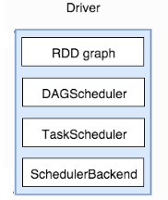
Driver (4)
Program Translation into Tasks
DAGScheduler
computes a DAG of stages for each job and submits them to TaskScheduler
determines preferred locations for tasks (based on cache status or shuffle files locations)
finds minimum schedule to run the jobs
TaskScheduler
responsible for
sending tasks to the cluster
running them,
retrying if there are failures, and mitigating stragglers
SchedulerBackend
backend interface for scheduling systems that allows plugging in different implementations (Mesos, YARN, Standalone, local)
BlockManager
provides interfaces for putting and retrieving blocks both locally and remotely into various stores (memory, disk)

Slide 9
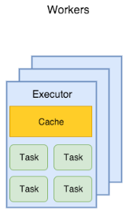
Executors
Worker processes responsible for running individual tasks in given Spark job
Launched when application is started and typically run till lifetime of application
Even if executors fails, Spark application does not fail
Roles of executors
Run the tasks and return the result to the driver
Provide in-memory storage for RDDs that are cached by user programs

Slide 10


Cluster Manager
Cluster manager is used to launch the Spark application
Pluggable component
Allows sparks to run on top of different external managers like YARN, Mesos as well as standalone cluster manager
Single script to submit your application to cluster i.e. spark-submit
With different options, it can be used to connect to different clusters
Used to manage the resources allotted to the application

Slide 11
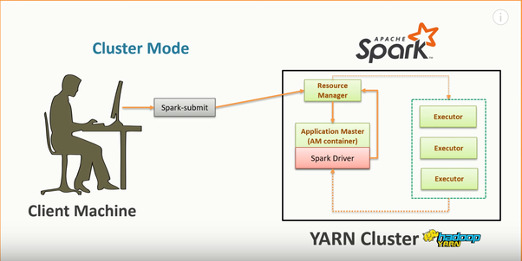
Application execution
Source : Quora answer

Slide 12
Application execution (2)
Detailed
User submits the application using spark-submit
Spark-submit launches the driver program and invokes the main() method of program
Driver program contacts the cluster manager to ask for resources to launch executors
Cluster manager launches the executors on the behalf of driver program
Driver process runs through user application
Based on RDD transformations and actions in the program, driver sends work to executors in form of tasks
Tasks are run on executor processes to compute and save results
If the driver’s main method exits or calls SparkContext.stop(), it will terminate all executors and release resources from the cluster manager

Slide 13
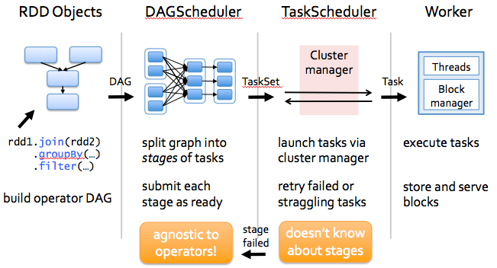
Application execution (3)
Application flow
Source : Spark Intro blog

Slide 14
Thank You!
Reference :
Learning Spark By Karau, Konwinski
Spark Documentation
In our next session: Spark Application Submission

